Slide 1
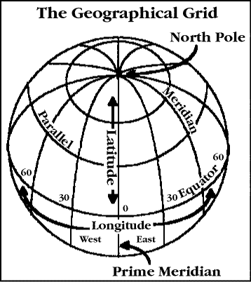
Latitude and Longitude

Slide 2
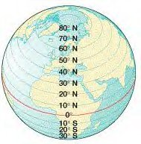
Latitude lines run east/west but they measure north or south of the equator (0°) splitting the earth into the Northern Hemisphere and Southern Hemisphere.

Slide 3
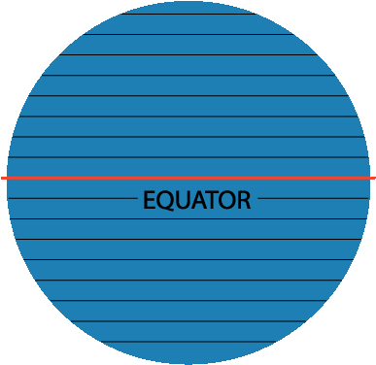
Latitude North Pole South Pole
90
80
Lines of latitude are numbered from 0° at the equator to 90° N.L. at the North Pole.
[
70
60
50
40
30
20
]
Lines of latitude are numbered from 0° at the equator to 90° S.L. at the South Pole.
10
10
20
30
40
50
60
70
80
90
Notes:
TEKS: Social Studies –
6.22 (A), Using social studies terminology correctly
7.22 (A), 8.31 (A)

Slide 4
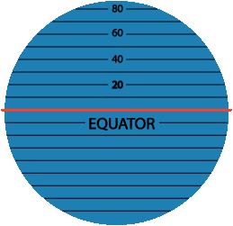
Latitude The North Pole is at 90° N The South Pole is at 90° S
The equator is at 0° latitude. It is neither north nor south. It is at the center between north and south.
40° N is the 40° line of latitude north of the equator.
40° S is the 40° line of latitude south of the equator.
Notes:
TEKS: Social Studies –
6.22 (A), Using social studies terminology correctly
7.22 (A), 8.31 (A)

Slide 5
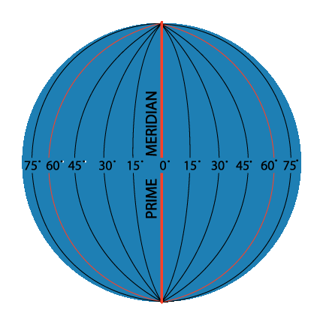
Longitude Lines of longitude begin at the Prime Meridian.
60° E is the 60° line of longitude east of the Prime Meridian.
60° W is the
60° line of
longitude west
of the Prime
Meridian.
The Prime Meridian is located at 0°. It is neither east or west
W
E
Notes:
TEKS: Social Studies –
6.22 (A), Using social studies terminology correctly
7.22 (A), 8.31 (A)

Slide 6
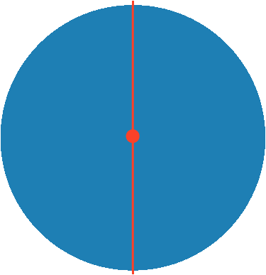
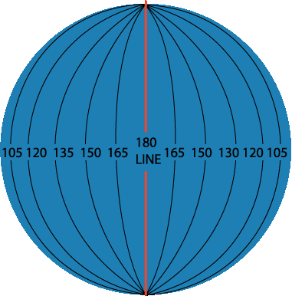
Longitude
180°
N
North Pole
W
E
West Longitude
East Longitude
PRIME MERIDIAN
S
Lines of longitude are numbered east from the Prime Meridian to the 180° line and west from the Prime Meridian to the 180° line.
Notes:
TEKS: Social Studies –
6.22 (A), Using social studies terminology correctly
7.22 (A), 8.31 (A)

Slide 7
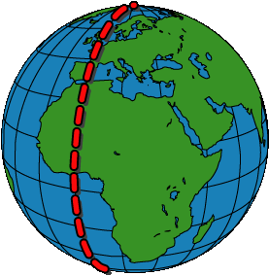
Prime Meridian The Prime Meridian (0°) and the 180° line split the earth into the Western Hemisphere and Eastern Hemisphere. Prime Meridian
Western Hemisphere
Eastern Hemisphere
Places located east of the Prime Meridian have an east longitude (E) address. Places located west of the Prime Meridian have a west longitude (W) address.
Notes:
TEKS: Social Studies –
6.22 (A), Using social studies terminology correctly
7.22 (A), 8.31 (A)

Slide 8
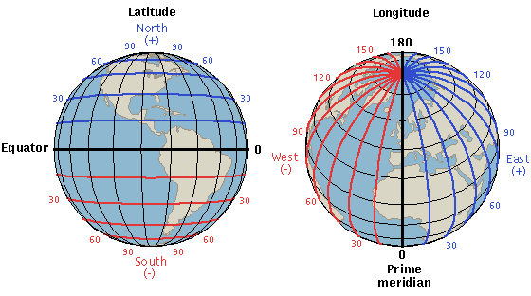
By combining latitude and longitude, any location can be pinpointed

Slide 9
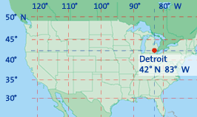
A location’s coordinates (____° N or S, ____ ° E or W)

Slide 10
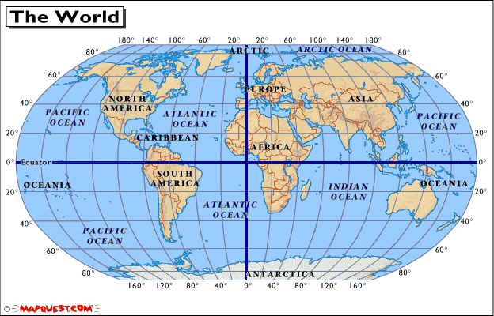
Application N
W E
S
North America is in the Northern Hemisphere because it is north of the Equator. North America is in the Western Hemisphere because it is west of the Prime Meridian.
Notes:
TEKS: Social Studies –
6.3 (B), Posing and answering questions about geographic distributions and patterns
6.22 (A), Using social studies terminology correctly
7.22 (A), 8.31 (A)

Slide 11
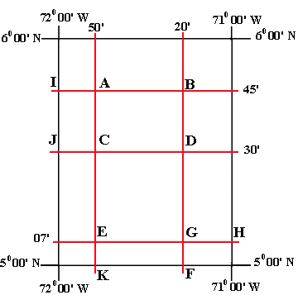
Fractions of a Degree
1 degree = 60 minutes or 1 minute is 1/60th of a degree
Use minutes if location is not directly on the latitude/longitude line
Written ----- Degree/minute = XX° xx’ compass direction
30’ is half-way between degrees

